Slide 1
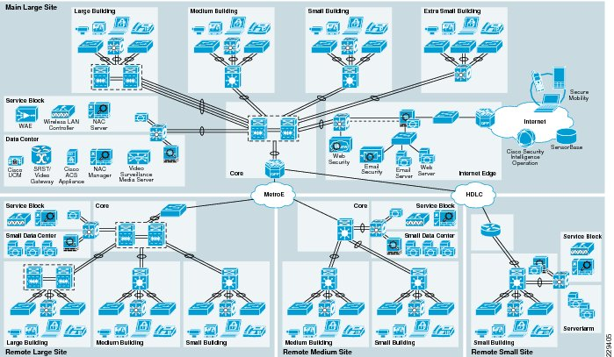
Enterprise Network Simulation
Cloud TAP
Network Simulation
Data Structures Implementation Guide
48
75+
C++
Network Devices
Connections
Implementation

Slide 2
Team Contributions
Roles are defined based on the nature of work performed during the project.
Abdul Wahid
Uneeb Ali
Technical Design & Implementation
Documentation Review & Coordination

Slide 3
Presentation Overview
Navigation
01
System Architecture
02
Core Data Structures
Foundation of network device modeling with Object-Oriented Programming principles
Fundamental data organization and management techniques including maps, sets, vectors, and deques
OOP Design
48 Devices
5 Departments
std::map
std::set
std::vector
std::deque
03
Advanced Implementations
04
Performance Analysis
Specialized structures for network optimization including ARP cache, routing tables, and BFS path finding
Computational complexity and optimization insights with real-world performance metrics
ARP Cache
Routing
BFS
Time Complexity
Optimization
Scalability

Slide 4
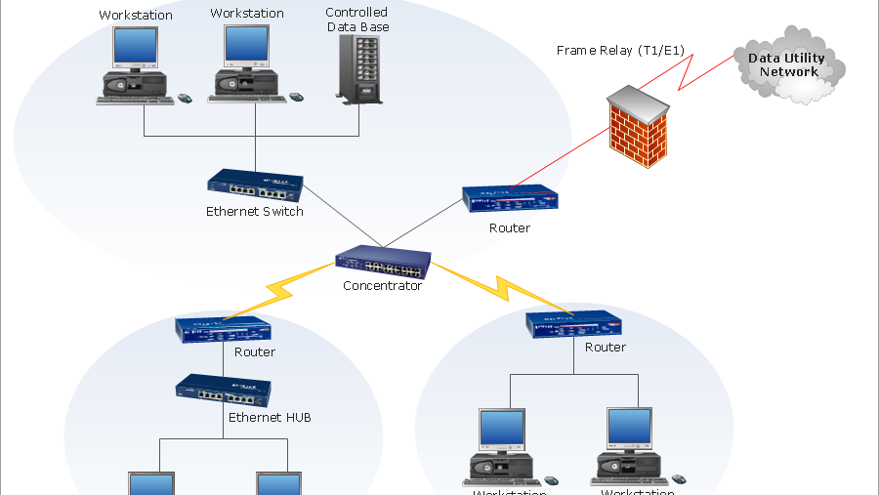
Chapter One
System
Architecture
Understanding the foundation of network device modeling through Object-Oriented Programming principles

Slide 5
SYSTEM ARCHITECTURE
System Overview
Cloud TAP System Architecture
Device Components
Cloud TAP models a complete corporate network infrastructure with realistic topology spanning 5 departments and 48 active network devices with 75+ physical connections.
Each network device is modeled as an object containing:
Device ID & Type - Unique identifier
IP & Subnet - Network addressing
48
75+
5
Connection Status - Active/Inactive
Devices
Connections
Departments
Services & Protocols - Features
OOP Design Principles
Department Breakdown
E
Encapsulation
Management
7
IT
7
Integrates data members and features into network device modules
Sales
7
Finance
7
A
Abstraction
HR
7
Total Devices
35+
Hides low-level complexity while presenting logical protocol behavior
M
Modularity
Every networking feature implemented as separate reusable module

Slide 6
SYSTEM ARCHITECTURE
Object-Oriented Design
E
Encapsulation
A
Abstraction
M
Modularity
Bundles data members and associated features into cohesive network device modules, ensuring data integrity and security.
Hides low-level networking complexity while presenting logical behavior of protocols to simplify development.
Every networking feature implemented as separate modules for maintainability, reusability, and clear code organization.
Benefits:
Benefits:
Benefits:
Data protection, modular maintenance, clear interface boundaries
Simplified usage, reduced cognitive load, protocol independence
Code reuse, easy testing, parallel development
Implementation Example
Device Hierarchy
// Device Class with OOP Principles
Base: NetworkDevice
classNetworkDevice {
Core properties and methods
private:
string deviceID;
Router
string ipAddress;
RoutingProtocol, RoutingTable
bool active;
public:
Switch
bool
VLAN, MAC Table
connect();
void
Server
sendPacket();
};
DHCP, Email, VoIP Services
Client
Desktop, Laptop, Mobile, Tablet

Slide 7
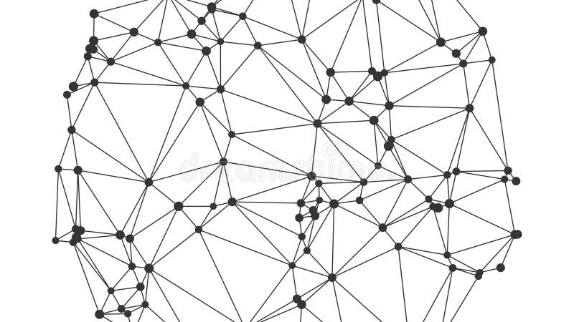
Chapter Two
Core Data
Structures
Fundamental data organization and management techniques powering network simulation

Slide 8
CORE DATA STRUCTURES
Data Structure #1: Device Registry - Map
Performance Characteristics
Why Map?
O(log n)
Efficient lookup by device ID using balanced binary search tree
Map provides the optimal balance between lookup speed and data organization for network device management.
Time Complexity
~5.6
<1ms
O(log n)
String-based device IDs enable human-readable naming
Avg Comparisons
Lookup Time
Scaling
Associative access pattern matches network topology
(48 devices)
(Sub-millisecond)
(Predictable)
Logarithmic scaling handles enterprise-scale deployments
Implementation Example
Automatic sorting maintains ordered device registry
// Device Registry Declaration
Unique keys prevent duplicate device IDs
std::map<string, Device> deviceRegistry;
// Adding Devices
NetworkDevicerouter("CORE-R1", "10.10.0.1");
Key Features
deviceRegistry["CORE-R1"] = router;
// Device Lookup
if (deviceRegistry.count("CORE-R1")) {
Automatic Sorting
Yes
NetworkDevice& dev = deviceRegistry["CORE-R1"];
Unique Keys
Guaranteed
dev.sendPacket();
}
Dynamic Size
Auto
Memory Management
Automatic

Slide 9
CORE DATA STRUCTURES
Data Structure #2: Network Connections - std::vector
Adjacency List Representation
Sequential Access Pattern
Vector stores network topology as adjacency lists for 75+ connections, enabling sequential access for network analysis and traversal algorithms.
Optimal for graph traversal algorithms and topology visualization
O(1)
O(n)
~50ns
Contiguous Memory: Cache-friendly iteration
Dynamic Resizing: Grows with network
Index Access
Traversal
Per Element
Implementation
// Connection Structure
Struct Connection {
String sourceID;
String targetID;
Int port;
Bool active;
};
// Network Topology
std::map<string, std::vector<Connection>> topology;
// Adding Connection
Connectionconn;
conn.sourceID = "CORE-R1";
conn.targetID = "L3-ACTIVE";
topology["CORE-R1"].push_back(conn);

Slide 10
CORE DATA STRUCTURES
Data Structure #3: Syslog Buffer - Deque
Queue-Based Event Logging
Performance Advantages
Deque implements a 1000-entry circular buffer for syslog events with O(1) insertion/deletion at both ends, critical for high-frequency system events.
Deque provides constant-time operations for event logging, critical for high-frequency system events.
1000
Circular Buffer Behavior
Double-ended: Push/pop at both ends
Maintains most recent events, discarding oldest when full. Double-ended structure enables push/pop at both ends with constant-time operations.
Chronological Order: Maintains event sequence
Buffer Size
Constant Time: O(1) operations
Circular Buffer: Automatic overflow handling
O(1)
O(1)
Push Operation
Pop Operation
Implementation
// Syslog Entry Structure
structSyslogEntry {
time_ttimestamp;
stringdeviceID;
stringmessage;
intseverity;
};
// Circular Buffer
std::deque<SyslogEntry> syslogBuffer;
constsize_tMAX_ENTRIES = 1000;
// Add Event
voidlogEvent(constSyslogEntry& entry) {
if (syslogBuffer.size() >= MAX_ENTRIES) {
syslogBuffer.pop_front();
}
syslogBuffer.push_back(entry);
}

Slide 11
CORE DATA STRUCTURES
Data Structure #4: DHCP Pool Allocation - Sorting
DHCP Management
DHCP Pool Configuration
Set provides O(log n) IP allocation and deallocation for 7 DHCP pools, maintaining unique addresses with automatic sorting.
Management
IT
10.10.10.0/24
Performance Metrics
IT
Sales
7
254
O(log n)
O(log n)
10.10.20.0/24
Allocate
Release
DHCP Pools
IPs per Pool
~7
Auto
Sales
Finance
Comparisons
Sorted
10.10.30.0/24
Implementation
Finance
HR
10.10.40.0/24
// DHCP Pool using Set
std::set<int> dhcpPool;
HR
Voice
// Initialize Pool (IPs 1-254)
10.10.50.0/24
for (inti = 1; i <= 254; i++) {
dhcpPool.insert(i);
Voice
}
Wireless
// Allocate IP
10.10.60.0/24
intallocateIP() {
if (!dhcpPool.empty()) {
Wireless
intip = *dhcpPool.begin();
10.10.70.0/24
dhcpPool.erase(ip);
returnip;
}
Key Advantages
return -1; // No IPs available
Set enables efficient IP management with automatic sorting and uniqueness guarantees.
}

Slide 12
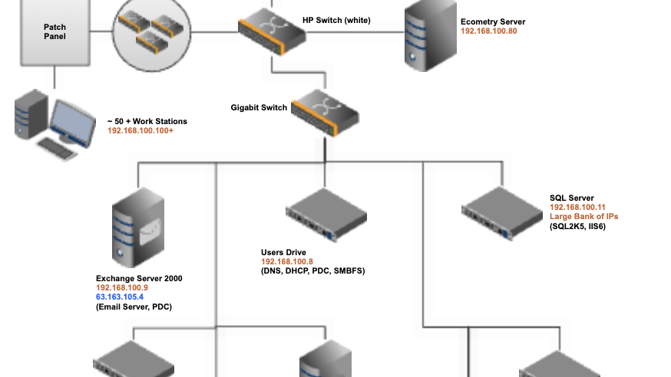
Chapter Three
Advanced
Implementations
Specialized data structures for network optimization and advanced routing

Slide 13
ADVANCED IMPLEMENTATIONS
Data Structure #5: ARP Cache - std::map + std::vector
Hierarchical Mapping
Structure Breakdown
Nested structure enables device-specific IP-to-MAC mappings with fast device lookup (O(log n)) and efficient address resolution through linear search in vector.
L1
Device ID (string key)
Fast O(log n) lookup via std::map
O(log n)
Linear
Device Lookup
ARP Search
L2
ARP Entries (vector)
Implementation
Linear scan through IP-MAC mappings
// ARP Entry Structure
structARPEntry {
Lookup Process
stringipAddress;
stringmacAddress;
time_ttimestamp;
1
Device Lookup: O(log n) map search
};
2
Vector Search: Linear scan through ARP entries
// ARP Cache Declaration
std::map<string, std::vector<ARPEntry>> arpCache;
3
MAC Resolution: Return MAC if IP matches
// Adding ARP Entry
voidaddARPEntry(conststring& deviceID, constARPEntry& entry) {
arpCache[deviceID].push_back(entry);
}
Benefits
Device Isolation
Fast Access
Scalable Design
Key Insight
Hierarchical design mirrors network topology and enables efficient address resolution.

Slide 14
ADVANCED IMPLEMENTATIONS
Data Structure #6: Routing Tables - std::vector
Longest-Prefix Matching
Sample Routing Table
Vector stores routing table entries enabling longest-prefix match for path determination, critical for OSPF protocol implementation.
Destination | Subnet | Next Hop | Metric
10.10.0.0 | /16 | 10.10.0.1 | 0
10.10.10.0 | /24 | 10.10.10.1 | 1
0.0.0.0 | /0 | 10.10.0.254 | 10
Longest-Prefix Match Algorithm
RouteEntry* findRoute(conststring& destIP) {
RouteEntry* bestMatch = nullptr;
intlongestPrefix = 0;
for (auto& route : routingTable) {
Sequential Scan Access Pattern
if (matchesPrefix(destIP, route.destination)) {
intprefix = calculatePrefixLength(route.subnetMask);
Linear search finds most specific route (longest prefix) for unweighted shortest path calculation.
if (prefix > longestPrefix) {
longestPrefix = prefix;
bestMatch = &route;
}
OSPF Integration: Dynamic route calculation
}
Prefix Matching: Most specific route wins
}
returnbestMatch;
Dynamic Updates: Real-time topology changes
}
OSPF Protocol Integration
Router ID: Unique identifier
Area Assignment: Link routers
Neighbor Discovery: Dynamic
Dead Timer: 35-second timeout

Slide 15
ADVANCED IMPLEMENTATIONS
Data Structure #7: Path Finding - BFS with std::queue
Breadth-First Search
BFS Algorithm Steps
Queue enables level-order traversal for unweighted shortest path calculation in O(V+E) time, essential for OSPF routing protocol.
1
Enqueue starting vertex
2
Dequeue and process vertex
O(V+E)
Linear in vertices (devices) and edges (connections)
3
Enqueue unvisited neighbors
Level-Order: Explores neighbors first | Shortest Path: Optimal for unweighted graphs | Queue Operations: O(1) enqueue/dequeue
4
Repeat until queue empty
Time Complexity
BFS Implementation
std::map<string, string> findShortestPath(conststring& source, conststring& target) {
std::queue<string> queue;
std::set<string> visited;
std::map<string, string> parent;
queue.push(source);
visited.insert(source);
while (!queue.empty()) {
stringcurrent = queue.front();
queue.pop();
if (current == target) break;
for (constauto& neighbor : topology[current]) {
if (visited.count(neighbor.targetID) == 0) {
visited.insert(neighbor.targetID);
parent[neighbor.targetID] = current;
queue.push(neighbor.targetID);
}
}
}
returnparent;
}

Slide 16
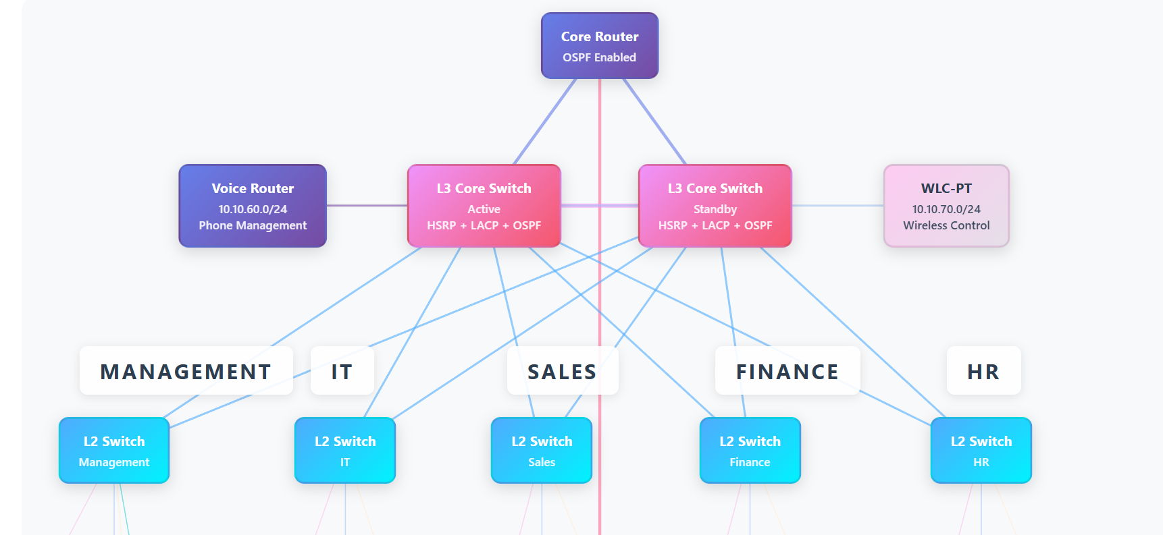
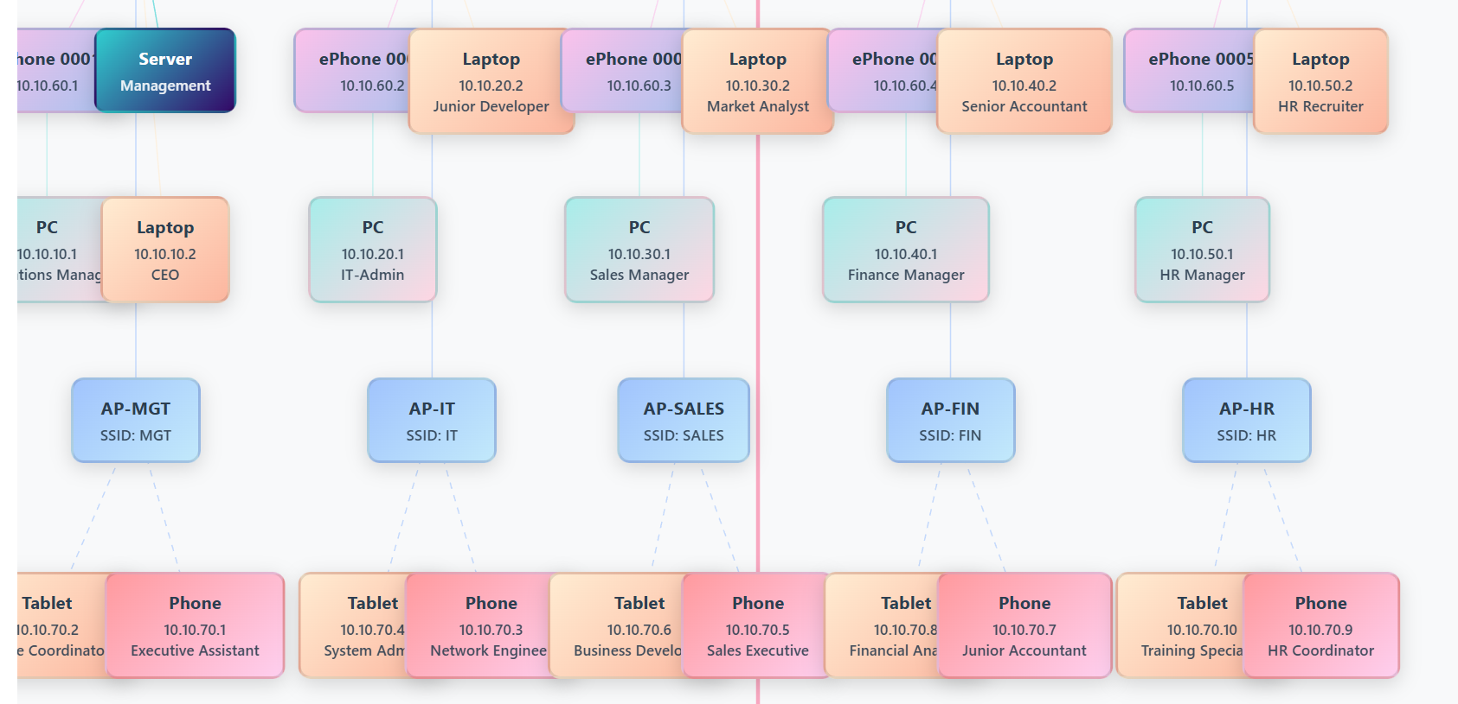
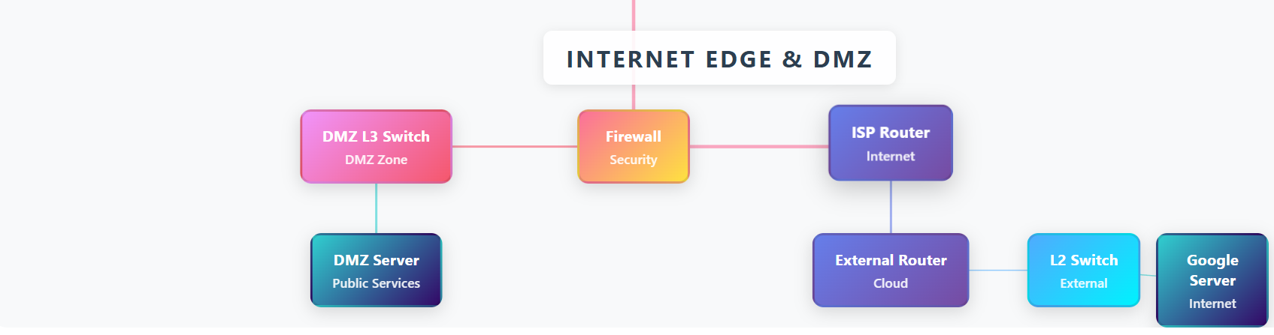
ADVANCED IMPLEMENTATIONS
Network Topology Visualization
Data Structures in Action
Topology Hierarchy
Visual representation of 48 network devices across 5 departments showing device registry mappings, connection vectors, and routing paths in the Cloud TAP topology.
C
Core Layer
CORE-R1: Central router
D
Distribution Layer
L3 Switches: Active/Standby
A
Access Layer
Department switches
E
End Devices
Clients, servers, phones
Data Structures in Use
std::map: Device registry
std::vector: Connections
std::map+vector: ARP cache
std::vector: Routing tables
std::queue: BFS path finding
Network Stats
48
75+
Devices
Connections
5
7
Departments
Data Structures

Slide 17
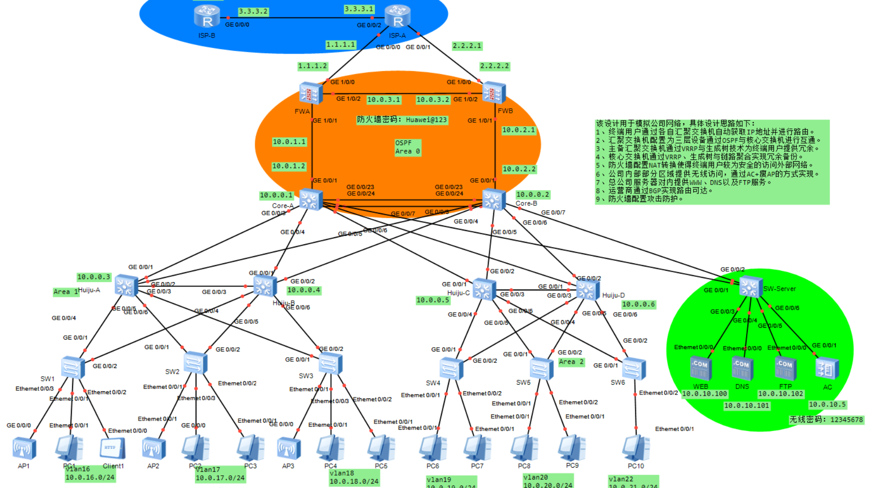
Chapter Four
Performance
Analysis
Computational complexity analysis and optimization insights for enterprise-scale network simulation

Slide 18
PERFORMANCE ANALYSIS
Performance Metrics & Complexity Summary
Complete Complexity Analysis
Key Metrics
Data Structure | Operation | Complexity | Performance
Device Registry (std::map) | Lookup | O(log n) | Sub-ms (48 devices)
DHCP Pool (std::set) | Allocate/Release | O(log n) | Sub-ms (254 IPs)
Network Connections (std::vector) | Traversal | O(n) | ~50ns per element
Syslog Buffer (std::deque) | Push/Pop | O(1) | Constant time
ARP Cache (std::map+vector) | Lookup | O(log n) | Device + linear scan
Routing Tables (std::vector) | Longest Prefix | O(n) | Sequential scan
Path Finding (std::queue) | BFS Traversal | O(V+E) | Linear in graph size
48
Devices
75+
Connections
<1ms
Avg Lookup
Scalability Insights
Logarithmic growth enables expansion
Predictable performance at scale
Memory-efficient implementations
Real-World Performance Impact
Real-time network operations
Data structure selection is critical for network simulation performance at enterprise scale (48 devices, 75+ connections).
Logarithmic Structures
Constant Operations
Linear Scans
Performance Highlights
Maps/sets provide predictable performance scaling
Deque enables high-frequency event logging
Vectors acceptable O(n) for reasonable n
Device Lookup:
~5.6 comparisons
DHCP Allocation:
~7 comparisons
Syslog Buffer:
1000 entries
Path Finding:
Linear time

Slide 19
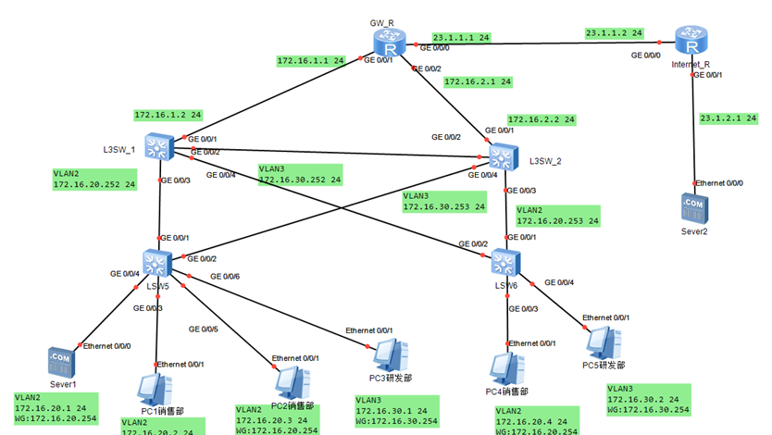
Implementation Complete
Data Structures
in Action
Real-world network simulation through efficient data organization
7
48
75+
Data Structures
Network Devices
Connections
Key Takeaways
1
Right Tool, Right Job
2
Performance Matters
Each data structure serves a specific purpose in network simulation
Complexity impacts user experience at enterprise scale
3
OOP + Data Structures
4
Scalability
Clean, maintainable code through object-oriented design
Logarithmic growth enables enterprise expansion
Network simulation successfully implemented with 7 data structures, 48 devices, and 75+ connections

